Slide 1
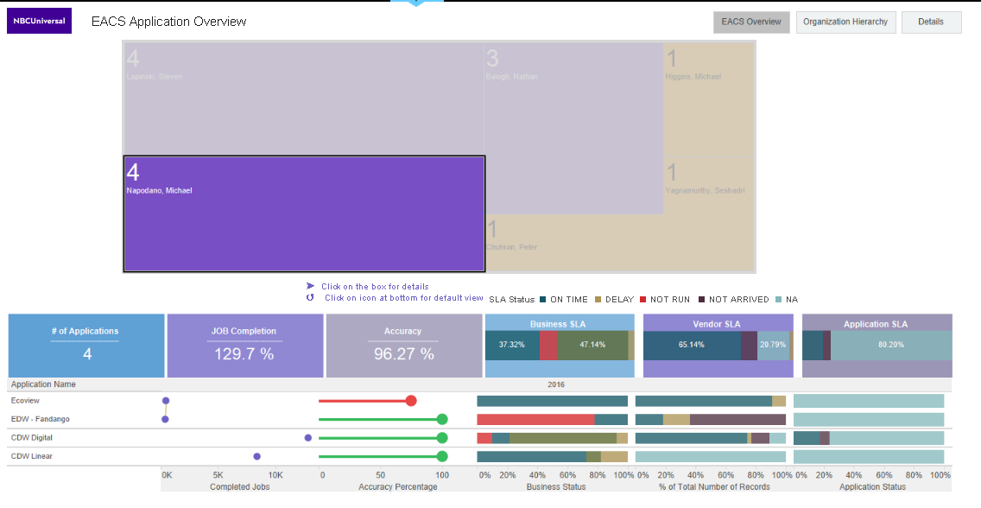
EACS Dashboard – Application Overview

